Slide 1






“Philosophy, Concepts and methods for linking EE / ESD with management of BRs & other designated areas
Prof. Michael Scoullos
UNESCO Chair & Network on Sustainable Development
Management and Education in the Mediterranean
University of Athens
Chair, MIO-ECSDE, GWP-med
Chair, Greek National Commission of ΜΑΒ UNESCO

Slide 2
Basic Axis of the book (a)
Fields of EE/ESD which are directly linked to BRs/Pas or may gain from such a link
What EE/ESD gains from BRs/PAs?
Where BRs/PAs are necessary for EE/ESD

Slide 3
Basic Axis of the book (b)
What are the processes in BRs/PAs and what are the activities of EE/ESD that can be developed in favour of BRs/Pas.
What BRs/PAs gain from EE/ESD ?
How EE/ESD may help the management?

Slide 4
An oversimplified perception:
«Environment = Nature»
Within a simplified approach PA means original natural environment, “virgin’’ natural landscape and high quality ecosystems.
Environment and Nature are considered by most people at first approximation as synonyms or identical.
Need for clarifications:
Basic principles of EE:
“about” (knowledge),
“in” (in direct contact with reality), the environment
“for” (commitment in favour of)
Thus, PAs were early enough identified on ideal places for EE

Slide 5
A dynamic system
The concepts, the institutions involved and the level of “comprehension/interpretation” of them (BRs, EE, ESD) are not static but evolving, having multiple nuances and approaches. They are open to explanations, clarifications and further “enrichment”.

Slide 6
The target group
common & differentiated contribution
Protection of biodiversity
GROUP 2
Educators
Principles of ESD
Methods of Education
GROUP 1
PA Managers
Principles of SD
Methods of Management
outdoor education
educators awareness
consensus building
Enhancement
of knowledge, behaviors & attitudes
Enhancing pride & ownership
Generation of income
Well being of the community,
surviving changes
GROUP 3
Local Communities, Tourism Industry

Slide 7
Nature’s observation as a learning tool
From the very beginning of education the direct contact with nature (being in nature) and observation (either in situ or in the laboratory) (invivo or invitro) was an important learning tool for empirical knowledge and deeper reflection.

Slide 8
Evolution in the relationship:
Man & Nature
In the ancient world, Nature & Divine (supernatural) were almost identical.
Even when we step ahead from naturalism and we see nature as «world»/«structure» from the point of view of literature, the “personification” of nature remains in the human conscience and the related cognitive and learning processes.

Slide 9
Man & Nature
UNDERSTAND
TAKE OVER
IMITATE
DOMESTICATE
sometimes
OBEY
HUMANS NATURE
PROVIDES
Takes REVENGE
ATTRACTS
REWARDS
TEACHES

Slide 10
Philosophical background of the relationship between man & the world; evident also in literature
ENVIRONMENT
ENVIRONMENT
man
man
nature
spiritual
natural
technological
manmade
Cultural
manmade

Slide 11
Background of Environmental Education (EE)
ENVIRONMENT
spiritual
man
Technological manmade
Cultural manmade
natural

Slide 12
Man & Nature
Already from the antiquity there is an attempt to relate lessons learnt about the “fury” or the consequences of the natural phenomena to human choices either as:
The God’s punishment for human “sins” (i.e. the Noe cataclysm).
As result of not obeying the rules of Nature i.e. the case of Ikaros.

Slide 13
In the roots of environmental awareness as it is identified today one may trace:
- Many ancient philosophical ideas as they survived and evolved until today.
- Pastoralism and nature worship of Jean-Jac Rousseau, etc.
The appreciation of indigenous rural people wisdom, culture and practices.
The Darwin’s theories on evolution, holistic thinking (“ecology”).
The living “Gaia” theories.
The systemic thinking (eco-system).
Social and health impact of the «Black Cities» of the Industrial Revolution.
The reactions for the “chemical war” of the First World War.
The reactions for nuclear energy and its impact (Hiroshima and Nagasaki).
The reactions to large-scale industrial accidents.
The fears to genetic engineering.

Slide 14
Goals of the establishment PAs
The first Natural (national) Park created in 1872 in Yellowstone, USA as «a public park and area for recreation for people’s benefit».
In 1911 in Canada: the first coordination unit worldwide.
Five years later in 1916 in USA the National Parks Service was established, having the important task of the management of protected areas.
In Greece, the first National Parks, the one of Olympus and of Parnassus were established in 1938.
Samaria & Olympus= the two BRs of Greece.

Slide 15
PAs as witnesses of environmental changes
The impacts of urban, industrial and air pollution were obvious in PAs, Natural Parks, etc.
- Acid rain impact (i.e. in the forest and PAs in Scandinavian countries)
The oil spills and litter in marine parks
Threats on species and loss of biodiversity even within many of the PAs.

Slide 16
Since 1960
People’s attitudes and learning as well as environmental protection are based in three levels of involvement:
- Self interest – personal benefit
- Social good – altruistic
Intrinsic value of environment –
ecocentric approach
usefulness-functioning of anthropocentric approaches

Slide 17
First joint initiatives for the protection of the environment
Limits to growth Report / ΜΙΤ Club of Rome
Stockholm Conference on the Human Environment (1972)
GOAL: The protection of the environment (natural and cultural)
Development
(economic, personal, social)

Slide 18
The causes of environmental degradation
Overpopulation
Consumerism
Economy having improper indicators
Lack of education & information
GOAL: The protection of the environment (natural and cultural)
Development
(economic, personal, social)

Slide 19
Environmental Education (EE)
Environment
Earth “Spaceship”
(limits to growth)
Human overstructure:
society, economy, institutions, etc.

Slide 20
Evolution in the Protection
First steps:
The protection of species in danger
Followed by:
The protection of particular isolated habitats / ecosystems (as “islands of protection”)
Similar approach by spatial planning experts, economists, archaeologists for other areas of special interest.

Slide 21

«Protection»
of habitat
phase Α
Approach of “archaeological sites/ museums”

Slide 22
Evolution in the Protection
Soon the limits of the “islands of protection” approach became apparent and the concept of protection evolved to cover wider zones, “zoning approach” (see industrial zones, areas of urban development, protected areas, etc.)

Slide 23
Protected Areas
IUCN – World Conservation Union “areas of land or sea, designated to ensure long- term protection and maintenance of biological diversity, as well as their natural and cultural value, which can be managed through legal or other effective ways”
Initially 10 categories of ecotypes (1978) that finally combined in the following six (1994):

Slide 24
IUCN categorization
Strict Nature Reserve: protected area managed mainly for science;
Ib: Wilderness Area: protected area managed mainly for wilderness protection;
II: National Park: protected area managed mainly for ecosystem protection and recreation;
III: Natural Monument: protected area managed mainly for conservation of specific natural features;
IV: Habitat/Species Management Area: protected area managed mainly for conservation through management intervention;
V: Protected Landscape/Seascape: protected area managed mainly for landscape/seascape
conservation and recreation; and
VI: Managed Resource Protected Area: protected area managed mainly for the sustainable use of natural ecosystems

Slide 25
Internationally important specially designated areas
Wetlands Ramsar Convention
UNESCO World Heritage Monuments.
Barcelona Convention Specially Protected Areas (SPA).
Biosphere Reserves UNESCO Man & the Biosphere (MAB) Programme

Slide 26
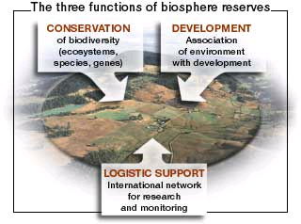
ΜΑΒ/UNESCO Biosphere Reserves (BRs) approach (1995)

Slide 27

ΜΑΒ/UNESCO Biosphere Reserves (BRs) approach
area of absolute protection
core
core
Buffer zone
Area of ‘transit’ protection
Area of limited protection

Slide 28
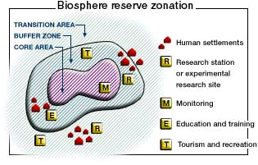

Slide 29
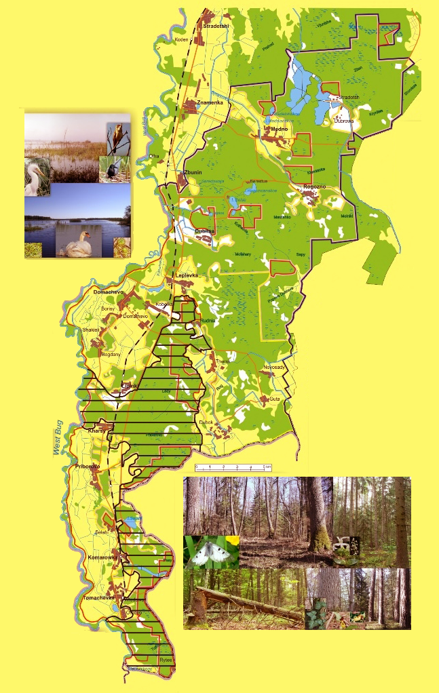
CORE
BUFFER
TRANSITION
BIOSPHERE RESERVE
Bribuzhkoye Polesie Biosphere Reserve (Belarus)

Slide 30
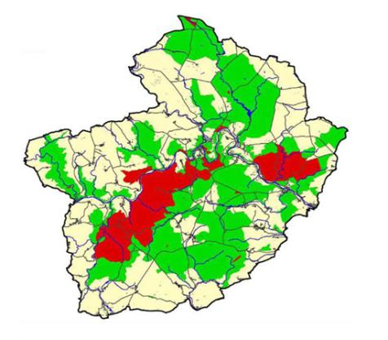
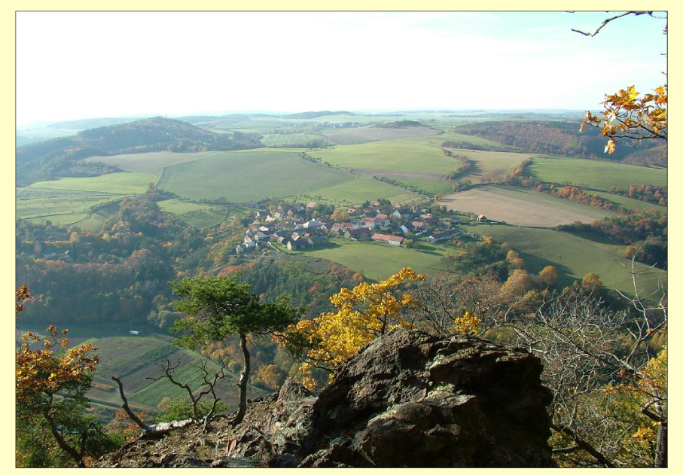
CORE ZONE
BUFFER ZONE
TRANSITION ZONE
Krivoklatsko Biosphere Reserve (Czech Rebublic)

Slide 31

BRs’ functions
Conservation (landscapes, ecosystems, species generic variation)
Logistic support (research, monitoring, ESD, training, knowledge)
Development (economic, human and culturally adapted)

Slide 32
Protected Areas
Convention for Biodiversity (1992)
« protected areas are identified geographical areas which are established and their management aims at the achievement of particular purposes of protection and conservation»
The ultimate goal is the Sustainable Development Newer and recent approaches:
Networks of PAs
Eco-Corridors
Cultural Paths

Slide 33
European Legal framework for PAs
Directive 79/409 on the conservation of wild birds
Directive 92/43 on the conservation of natural habitats and of wild fauna and flora
Natura 2000, Network of Protected Areas.
2 types of areas: “Special Protection Areas – SPA” and “Sites of Community Importance – SCI”.

Slide 34
Protection is not always “desired”
The establishment of PAs is one of the most difficult social issues due to frequent reaction by local communities :
They do not want to be “under protection”
They wish the same type of “development” as all other areas.

Slide 35
Sustainable development approach to the establishment PAs
Protection of natural and cultural characteristics with the direct or indirect support/participation of the local society. This includes :
Habitats’ protection
Conservation of species generic variations
Promotion of scientific research
Conservation of natural, cultural and traditional (heritage) elements
Education
Recreation and development of sustainable tourism and other compatible to SD activities (human and culturally adapted)
Sustainable management of natural resources.
Conservation of a set of services and goods necessary for the well being of current and future generations.

Slide 36
1960s & 1970s: Introduction of EE
An alternative approach to the environment but also to education
Its explicit aims were often concerned with stimulating a sense of individual responsibility for both the natural and manmade aesthetic/cultural environment, based on general ecological principles and knowledge of the scientific bio-geo-chemical cycles and observation of a series of impacts of human activities on them.

Slide 37
First steps of EE
Limits to Growth Report - Stockholm Conference on the Human Environment (1972)
Belgrade (1975) & Tbilisi (1977) documents on EE emphasized the need to build knowledge, acquire comprehension & decision making skills and adopt values & attitudes which could protect the environment.

Slide 38
Key Methodologies
“about” (knowledge),
“in” (in direct contact with reality),
“for” (commitment in favour of) the environment.
Combination of knowledge with action.
The learners in the centre.
Multidisciplinary approach.

Slide 39
During the 80’s & 90’s
“Unbalanced” evolution of EE in the various countries.
Ideological and other constrains in implementation
Moscow Congress on EE & Training (1987): more emphasis on the gender issue, health, poverty & peace.
Endeavours to effectively tackle the environmental problems based on reliable scientific research.
The precautionary principle.
Introduction of a series of “targeted” forms of education i.e. Education for Development, Global Education, Education for Peace and Human Rights, Education for Women, Education for Citizenship.
Establishment of the first national and international networks on EE supported by UNESCO and other international organisations.

Slide 40
The Rio UN Conference on
Environment and Development 1992
Chapter 36, Agenda 21
Sustainable Development
Environment
Ecology
Economy
Society

Slide 41
The Thessaloniki International Conference (1997):
EE only to support environmental protection or having a broader role?
Sustainable Development
Environment
Ecology
Economy
Society
EE to where??

Slide 42
The Thessaloniki International Conference result:
Sustainable Development
Environment Ecology
Economy
Society
Education for Environment & Sustainability (EfES)
Expansion of EE => Education

Slide 43
An attempt was made by the EU to define SD as the common place of the three components. This scheme asks that all three are satisfied in the same degree simultaneously!
ECONOMY
SOCIETY
ENVIRONMENT
Sustainable Development
and Education for Sustainable Development

Slide 44
after Thessaloniki
The ERA-21 campaign by MIO-ECSDE and other initiatives
Bali 2002 Preparation meeting of WSSD
WSSD Johannesburg 2002, establishment of MEDIES as a Type-2 initiative
ESD and the Decade for ESD
(UNESCO as the lead agency)

Slide 45
Sustainable Development is a pyramid and its basis is Education
Our vision through the evolution since Thessaloniki
Environment
Economy
Society
Education

Slide 46
Environment
Economy
Society
Governance
However, with Education alone we cannot transform all development into a sustainable one. Education is only one component of the overall “Governance”. The basis here is Governance.

Slide 47
Governance
Economy
Society
Environment
In fact, this scheme where environment is the natural basis and all other three are human overstructures is very close, but still different representation of the original starting point of EE.

Slide 48
Analysis of Governance for the Implementation of SD
Institutions
Education
Science
& Technology
Governance

Slide 49
Combining the previous figures we have Sustainable Development as a double pyramid. One of its facets is Education
Economy
Society
Environment
Governance
Education
Institutions
Science & Technology

Slide 50
To obtain Sustainable Development we need:
Responsible
Economy
Social Cohesion
& Welfare
Environmental
Protection
Governance
Education for Sustainable Development
Effective Institutions
(Good planning, etc)
Application of innovative science & appropriate technology

Slide 51
The contents of ESD
Economy
Society
Environment
Areas that need “change” or reconsideration in order to achieve SD
Science & Technology
Institutions
Culture

Slide 52
The anxiety of “change”
“ This world will never change “
Change
“Everything is changing”

Slide 53
The spectrum of areas that need reconsideration, change, for putting ESD into practice
reconsideration
Conservation
Stabilisation of “roots”
Total reconstruction
Complementation
Adaptation

Slide 54
Everything is changing rapidly: No reference
Computers, Internet, the rapidly growing impacts on the planet by pollution, on one hand, and globalisation of the economy on the other, resulted in the shrinking of our planet and require reorientation of the focus of our Education
NEED FOR STABILITY, CONTINUITY AND REFERENCE.
Within this framework EE evolves in ESD

Slide 55
Nothing is changing
Wars, greed, inequity.
“Rule of power” based on money and violence.
Victims among the innocence, frequently among women and children.
The ideas guide us but their implementation is lagging behind.
NEED FOR CHANGE
Within this framework EE evolves in ESD

Slide 56
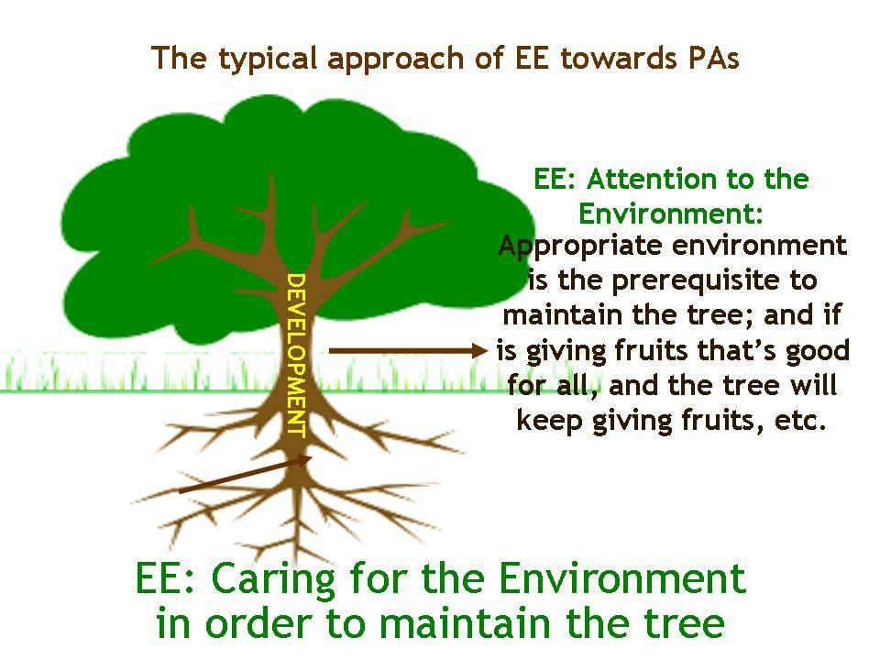
FROM
DEVELOPMENT
Appropriate environment =
the prerequisite to maintain the tree
EE: Attention to the ENVIRONMENT!
EΕ: Caring for the ENVIRONMENT
in order to maintain the tree

Slide 57
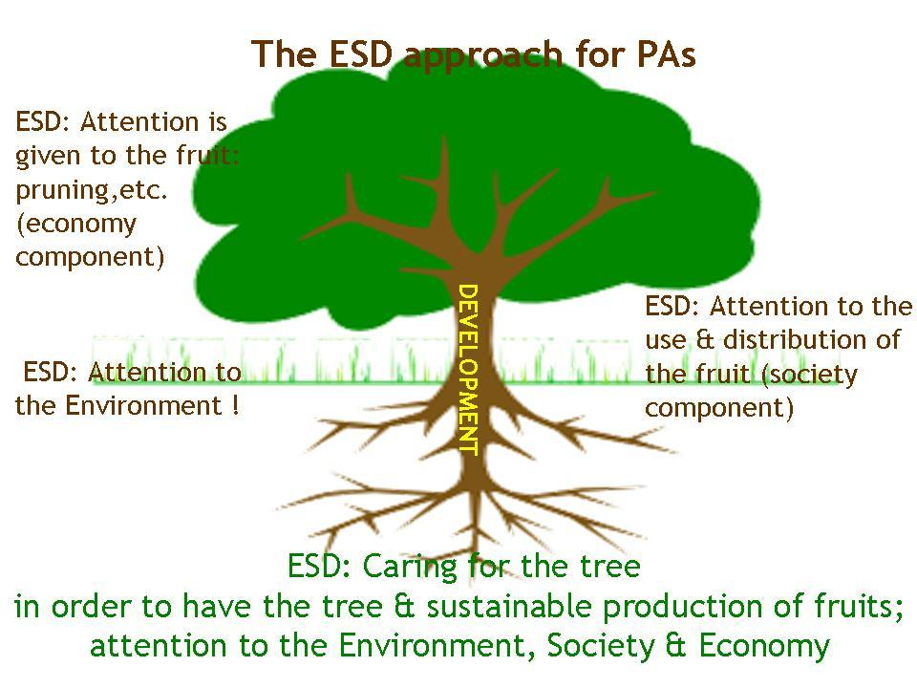
TO
ΕSD
Attention is given to the fruit: pruning,etc.
(ECONOMY)
DEVELOPEMNT
ΕSD
Attention to the use and distribution of the fruit
(SOCIETY)
ESD: Attention to the Environment !
ΕSD: Caring for the tree
in order to have the tree & sustainable production of fruits
Attention to the Environment, Society & Economy

Slide 58
ESD Characteristics & Principles
By nature, an evolving and dynamic concept seeking to balance human and economic welfare for the present and future generations with cultural values and respect for the environment and the earth’s natural resources.
- Aims to empower all people of all ages to develop the appropriate knowledge and skills; to adopt attitudes and values and shape behaviours towards sustainable development in order to assume responsibilities for creating a sustainable future.

Slide 59
ESD Characteristics & Principles
A cross-cutting field, embracing Environmental Education, Education for Development, Global Education, Education for Peace and Human Rights, etc.
Key Themes : poverty, citizenship, peace, democracy, security, human rights, social and economic development, health, gender equity, cultural diversity, functioning and protection of the environment and natural resources, sustainable production and consumption patterns.

Slide 60
ESD Characteristics & Principles
From:
Disciplines Multidisciplinarity (EE)
Intradisciplinarity
Transdisciplinarity
(central for ESD)

Slide 61
Particular goals of EE/ESD programmes in BRs/PAs
To highlight the special characteristics of the area.
To highlight the local issues and the opportunities for development and progress.
To encourage the locals on how to preserve and manage the area in a sustainable way.
To help the visitors to contribute in the sustainable development of the area.
To obtain nice memories and positive feelings that they can have an input in the sustainable management of the area.
To stimulate or enhance the tendency for expansion or creation of new BRs/PAs.

Slide 62
Current challenges of ESD in order to overcome tentions and lead to balance between:
Global | Local
Social | Personal
Heritage | Novelty
Competitiveness | Equality to opportunities
Rapider explosion of produced knowledge | Limited capacity to assimilate information
Spiritual | Material

Slide 63
Post DESD agenda
Nov 2011: the UNESCO General Conference requested to develop options for transforming the UN Decade of ESD into an institutionalized process beyond 2014
June 2012: In Rio+20 countries committed to strengthening ESD beyond Decade
Nov 2012: The UNESCO Executive Board requested a “programme framework” as follow-up to the Decade.
Oct 2013: The UNESCO Draft Global Action Program is under global consultation and will be presented in the next EB
2013: Throughout the year various online consultations & forums for the future of the Decade take place …
2014: The third and final assessment report of UNESCO will be launched at the 2014 World Conference on ESD

Slide 64
The target group
common & differentiated contribution
Protection of biodiversity
GROUP 2
Educators
Principles of ESD
Methods of Education
GROUP 1
PA Managers
Principles of SD
Methods of Management
outdoor education
educators awareness
consensus building
Enhancement
of knowledge, behaviors & attitudes
Enhancing pride & ownership
Generation of income
Well being of the community,
surviving changes
GROUP 3
Local Communities, Tourism Industry

Slide 65
All the afore mentioned challenges should ideally be experimented in the BRs/PAs
Both educators and BR managers should be prepared and trained to the extent possible, to help learners in order to face these challenges with wisdom, understanding, solidarity, courage and hope.

